Slide 1
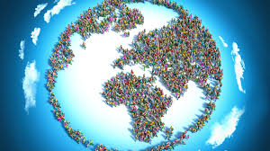
Populatıon
Jamel ben chafra

Slide 2
What does populatıon mean?
It is the total number of humans currently living.
Experienced continuous growth since the 14th Century.
Depends on fertility and mortality rates.
Notes:
Don’t forget to mention that the world population reached 8 billion in mid-November 2022!

Slide 3
Population by Region (in millions)
Region | Population (2022)
Sub-Saharan Africa | 1,152
Northern Africa and Western Asia | 549
Central Asia and Southern Asia | 2,075
Eastern Asia and Southeastern Asia | 2,342
Europe and Northern America | 1,120
Latin America and the Caribbean | 658
Australia and New Zealand | 31
Oceana | 14

Slide 4
Factors driving population growth
Fertility Rate
Age Structure
Infant Mortality Rate

Slide 5
World Population Challenges
Population size
Population ageing
Population policies

Slide 6
World Population Challenges
Population size
Population ageing
Population policies
Health Improvements

Slide 7
Be aware of ageing population !

